Slide 1
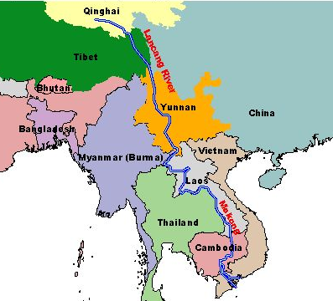
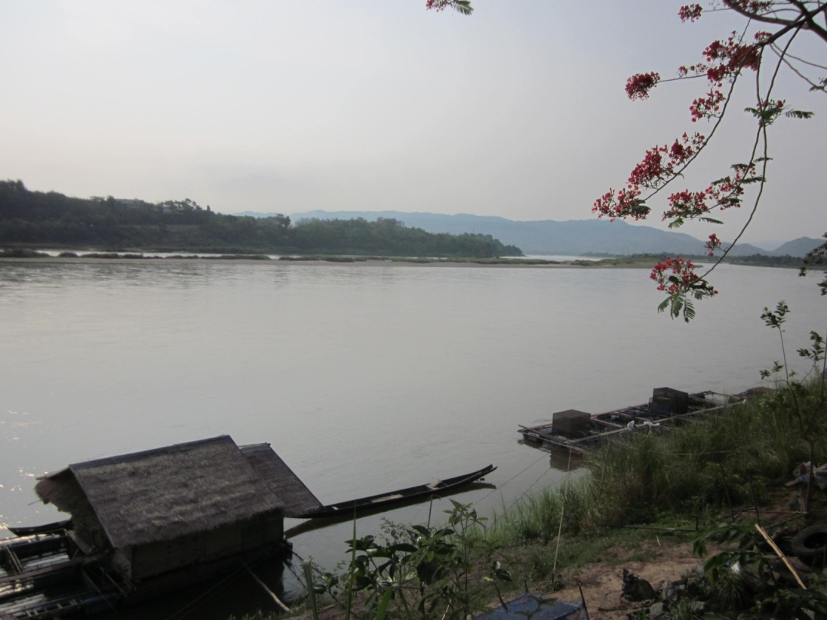
SITUATION REVIEW OF GOODS TRANSPORTATION ON
LANCANG-MEKONG RIVER AFTER R3A COMPLETION
Sunanta Charoenpanyaying, Jittichai Rudjanakanoknad
Transportation Institute, Chulalongkorn University

Slide 2
Topics
Overview of Transportation on Mekong River
Existing Transportation Condition
Development Plans and Effects
Preliminary Analysis
Concluding Remarks

Slide 3
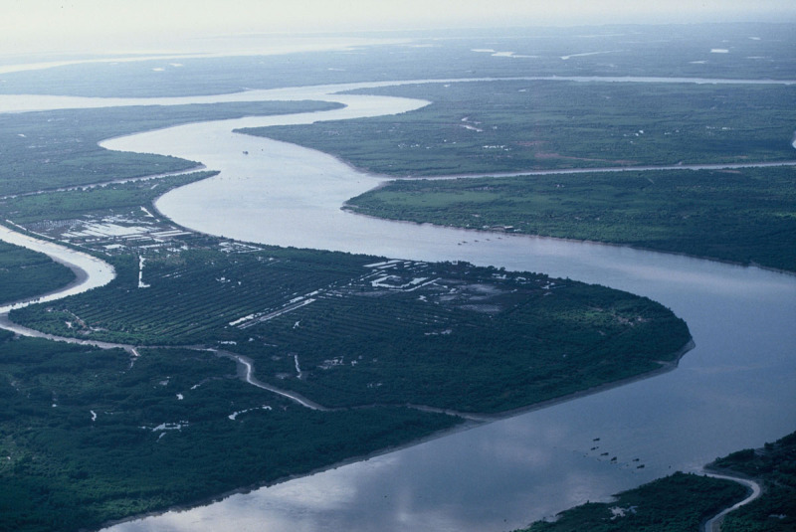
Lancang-Mekong River
The world’s 12th longest river
The 7th longest in Asia.
4,350-km length
Covers the area of 795,000 sq.km.
A trans-boundary river in Southeast Asia between Thailand, Myanmar, and Laos.
A major trading route linking China’s Yunnan province to Laos, Myanmar and Thailand to the south.

Slide 4
Agreement on Commercial Navigation on the Lancang-Mekong River 2000
Began in 2000 by China, Laos, Thailand, and Myanmar; expanded from the Agreement between China and Lao PDR on Freight and Passenger Transport along the Lancang–Mekong River
Objective: to promote tourism and to strengthen cooperation in commercial navigation
“Vessels of four countries can navigate freely between Simao to Luangprabang without charges”
Covers 14 ports in 4 four countries: Simao, Jinghong, Menghan and Guanlei – in China, Ban Sai, Xiengkok, Muangmom, Ban Khouane, Huayxai and Luangprabang – in Laos, Wan Seng and Wan Pong – in Myanmar, and Chiang Saen and Chiang Khong – in Thailand
States the mechanism how to deal with casualty, environment protection, immigration and customs, crews, etc among four nations.

Slide 5
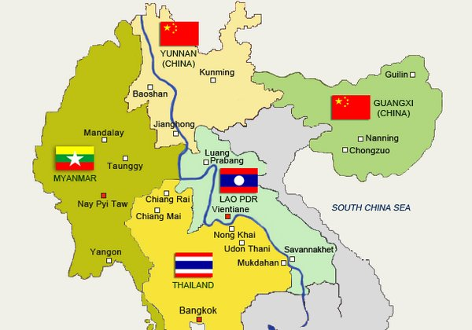
Overview of Transportation on Mekong River
Course of Upper Mekong River
Begins as Lancang on the Tibetan Platueu in Sanjiangyuan National Nature Reserve.
Flows through the Tibetan Autonomous Region and then southeast into Yunnan Province
Meets the tripoint of China, Myanmar and Laos, and forms the border of Myanmar and Laos for approximately 400 km until the Golden Triangle tripoint of Myanmar, Laos and Thailand.
Turns east into Laos before meeting the border with Thailand for approximately 850 km. Then, it again flows into Laos

Slide 6
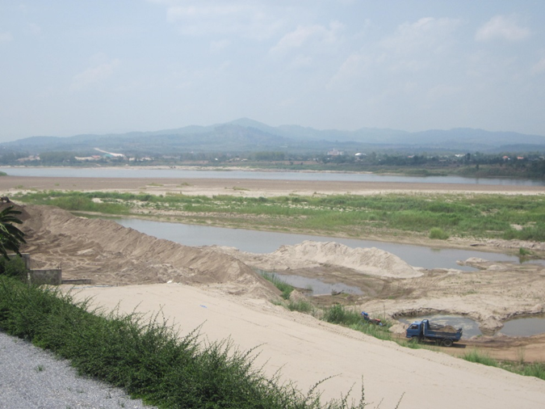
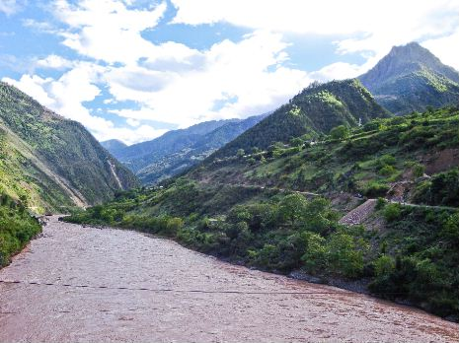
Overview of Transportation on Mekong River
Physical Condition for Transportation
In Yunnan, the river is confined by narrow, deep gorges.
In Simao and Xishuangbanna, it becomes open out, wider, and water flows slower.
Narrower and turbulent water stream in the upper Mekong in China along with huge annual water level fluctuations present a challenge to navigation.
Shipping route from China practically ends at Chiang Saen port due to sand dune and shallow depth
300,000 tons of goods shipped via this route each year

Slide 7
Overview of Transportation on Mekong River
CHINA
Agriculture products
Steel, textile
Timber, Agriculture products, Construction Materials
Wood
MYANMAR
LAO PDR
Vegetable, Fruits, Agriculture products, Fertilizer
Dry fruit,
Fish oil, Rubbers, Consumer goods
TYPE OF GOODS
THAILAND

Slide 8
Overview of Transportation on Mekong River
Ports – M-L Agreement
1. China – 4 ports, i.e., Simao, Jinghong, Menghan and Guanlei
2. Laos – 6 ports, i.e., Ban Sai, Xiengkok, Muangmom, Ban Khouane, Huayxai and Luangprabang
3. Myanmar – 2 ports, i.e., Wan Seng and Wan Pong
4. Thailand – 2 ports, i.e., Chiang Saen and Chiang Khong

Slide 9
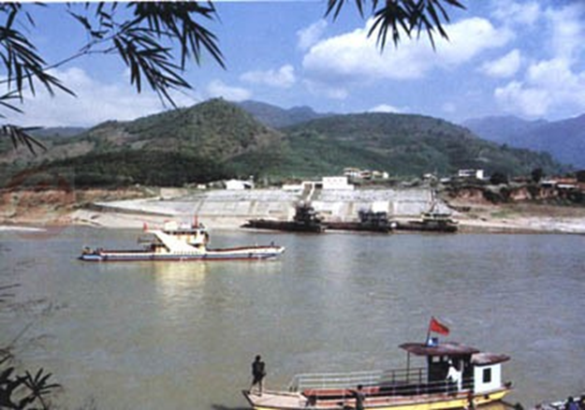
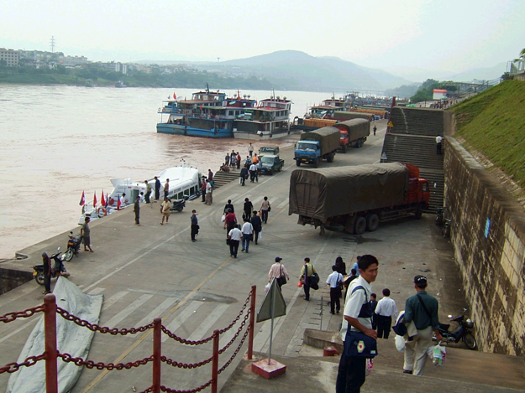
Overview of Transportation on Mekong River
Simao Port, Yunnan, PRC
Most upstream location
Can serve two 120-DWT vessels.
Capacity is 300,000 tons per year
Jinghong Port, Yunnan, PRC
Can serve two 100-DWT vessels.
Capacity is 150,000 tons per year
Use for tourist passenger transport from Yunnan to Luangprabang

Slide 10
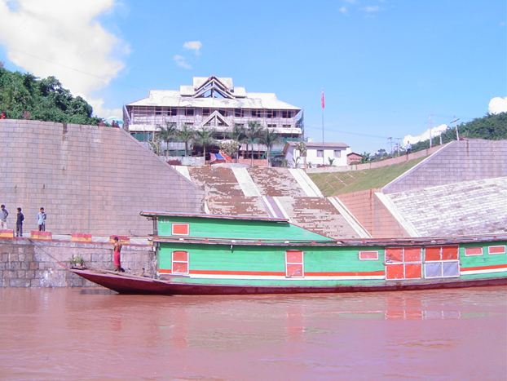
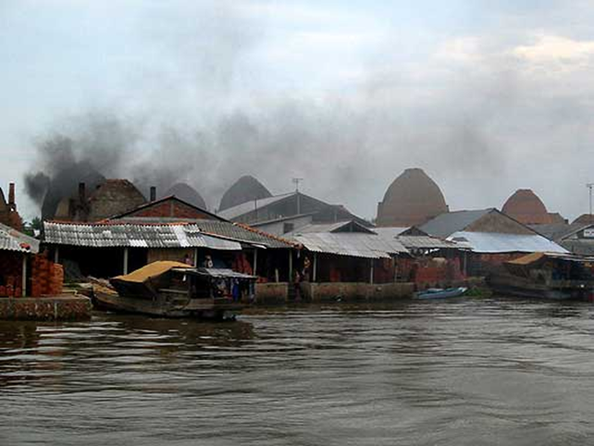
Overview of Transportation on Mekong River
Guanlei Port, Yunnan, PRC
can serve two 100-DWT vessels and serve passenger cruise
A port city & container port is being built near Guanlei Port
Wan Pong Port, Myanmar
Main connection between Myanmar and Yunnan on Mekong River
Controlled by Shan minority group
Pirate attacks and freight vandalism were occasionally found around here

Slide 11
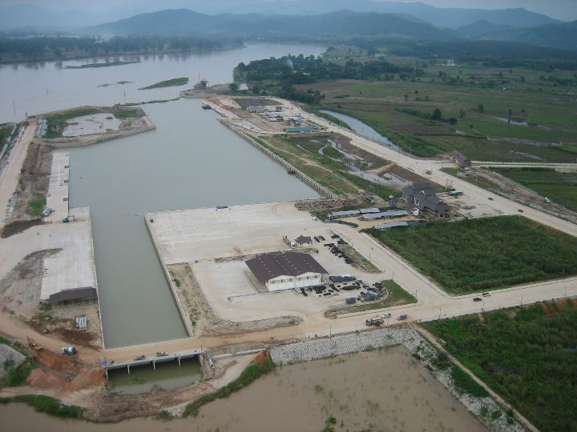
Overview of Transportation on Mekong River
Chiang Saen Port, Thailand
New one was opened in 2012, 10-km south of old port
Berth capacity can accommodate ship less than 200 Gross tonnage, 50 meters in length and 2 meters in depth
has one-stop service office for facilitating shippers

Slide 12
Existing Transportation Condition
Distance & Travel Time
Items | Origin-Destination | Distance/Travel Time
1. Distance | Chiang Khong Port – Chiang Saen Port | 70 km
 | Chiang Saen Port – Jinghong Port | 380 km
 | Jinghong Port – Simao Port | 90 km
2.Travel Time | Chiang Saen Port – Jinghong/Guanlei Port | 3 days (upstream)
 | Jinghong/Guanlei Port - Chiang Saen Port | 2 days (downstream)
Transport Cost
Cost of transport varies depending on type of goods and season. In some season, with less transportation demand, cheaper cost can be negotiated. Labor cost of unloading and loading goods could be varied.

Slide 13
Existing Transportation Condition
Recent Trade Value
The trade was disrupted from time to time due to:
Maintenance of water draft by China government (2002-2003)
Climate change and upstream dam construction brought too low water depth (2004)
Chinese cargo ships were attacked on a stretch of the Mekong River in the Golden Triangle region on the borders of Burma and Thailand, China temporarily suspended all Chinese shipping on the Mekong. (2011)
In 2013, total trade values (China-Chiang Saen) were 7,872.88 million baht (4,788.82M exports + 3,084.16M imports) with 85% are agricultural products.

Slide 14
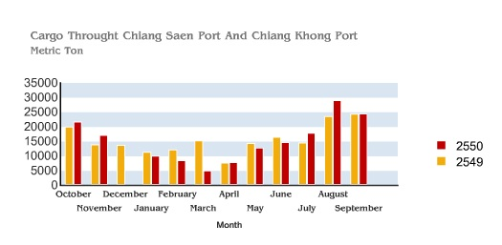
Existing Transportation Condition
Physical Challenges
Narrower and more turbulent sections of water in the upstream with large annual water level variations are major challenges
Volumes of trade being shipped decrease by more than 50 per cent, primarily due to the reduced draughts available during the low water season
Peak period is between June to December

Slide 15
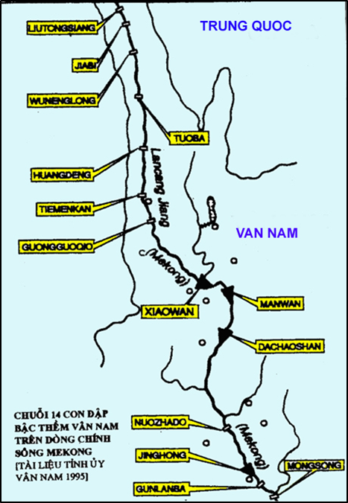
Existing Transportation Condition
China Dredging Program & Dams
In 2000, China initiated the Quadripartite Agreement to facilitate large vessels and not allowing all other activities that could obstruct river way and announced 200 million Yuan of dredging program but the progress is limited
Yunnan Province has plans building more than 10 dams along Lancang River to produce hydroelectric power for Yunnan.
China hopes that this will stabilize downstream water levels, decrease currents and increase depth of the river which will all improve navigability.

Slide 16
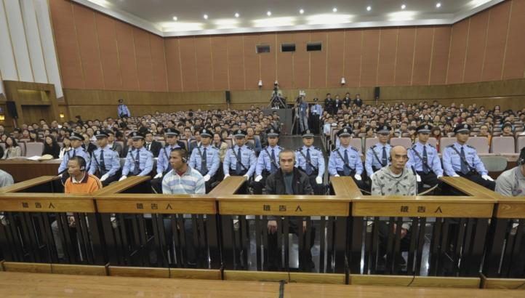
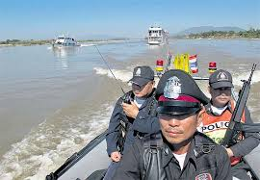
Existing Transportation Condition
Non-Physical Challenges
Gangster and pirates have posed dangerous conditions for commercial navigation and transported goods
Golden Triangle has been one of the most extensive opium-producing areas of Asia and of the world since the 1950s.
On October 5, 2011, two Chinese cargo ships were attacked on Mekong River in the Golden Triangle region. All thirteen crews on the two ships were killed and dumped in the river.

Slide 17
Impact of Transportation Development Plan (1)
Plan/Project | Range/Year | Type/Degree | Note
Dual-track railway project to Chiang Khong | Long-term (after 2020) | Affect Mekong shipping negatively Mekong shipping since R3A would be more convenient and easier for rail transfer. | The development of Chiang Khong by both government and private sectors mean less development in Chiang Saen port or Chiang Saen area.
Logistics Park at Chiang Khong | Long-term (after 2015)
Laos Railway Project | Long-term (>5-10 years) | Affect Mekong shipping negatively since rail is more efficient for freight and containers shipping | This project is still on negotiation. It has lots of uncertainty esp. on financial deal.

Slide 18
Impact of Transportation Development Plan (2)
Plan/Project | Range/Year | Type/Degree | Note
Tonpheung International Airport | Long-term (after 2018) | Might not affect freight transport on Mekong since river transport is much cheaper for time-insensitive goods. | This project might slightly have negatively effect on Mekong cruise tourists since air travel from Kunming is faster
Lao - Burma Friendship Bridge | Long-term (after 2016) | Could affect freight volumes on Mekong for China-Myanmar trade. | This project paves a much easier connection from R3A to Myanmar (instead of rugged terrain R3B). Truck transport from China to Myanmar could use this route.

Slide 19
Impact of Transportation Development Plan (3)
Plan/Project | Range/Year | Type/Degree | Note
Kyaukphyu-Kunming Railway Project | Unlikely to happen before 2025 | If happens, would decrease China-Myanmar volumes on Mekong shipping significantly. | Due to minority problem in Myanmar and conflict with central government, this project is unlikely to happen in next five years.
Lancang Airport | Long-term (after 2018) | Might not affect freight transport on Mekong since river transport is much cheaper for time-insensitive goods. | It would reduce tourists on Mekong and R3A route but no effect to freight transport on Mekong.

Slide 20
Impact of Transportation Development Plan (4)
Plan/Project | Range/Year | Type/Degree | Note
BCIM Corridor | Long-term (after 2020++) | If happens, would decrease China-Myanmar volumes on Mekong shipping significantly. | This project is at the start point and unlikely to come up with the construction plan soon. However, it would affect greatly to China-Myanmar trade.
Mekong joint military patrols | Short-term | This ongoing project might make Mekong shipping a bit safer but it could add delay and cost to regular lawful ships due to a lot of patrol. | Due to large scale of Mekong, the patrol is very difficult to catch the pirate and illegal goods. At the same time, regular lawful ships might be delayed from lots of investigation.

Slide 21
Preliminary Analysis
Competing Route
1) R3A/R3E: Kunming-Mohan-Boten-Huayxai-Chiang Khong-Chiang Rai-Bangkok, completed with the opening of 4th Thailand-Laos Friendship Bridge in December 2013.
Popular among the shipments that require faster travel time to Thailand. Recent data show that the parts of trade volumes has been shift from Chiang Saen to Chiang Khong.
2) R3B: Chiang Tung-Thakilek(Myanmar)-Mae Sai-Chiang Rai-Bangkok.
unusable due to poor road condition in Myanmar and unreliable of Mongla-Daluo border crossing point.
3) Air Transport
No effect on freight transport since goods shipped through air are very time-sensitive and expensive but it could affect pax transport due to travel time reduction.
Only R3A is the viable competitor.

Slide 22
Preliminary Analysis
Advantage of Mekong Shipping
Already well-established
Less problems on border crossing
Cheaper for bulk items
Advantage of R3A Shipping
Required Experienced Navigation Skill
Risk from Drug Gangster and Robbery
Unreliable Water Draft in Dry Season
Access to river ports is difficult from major highways

Slide 23
Preliminary Analysis
Benefit of Mekong Shipping by Country
Yunnan, PRC
Lao PDR
Market & Trade Expansion
Route Control
Expansion of Yunnan Economy
Cheaper Import Goods from China
Revenue from Port Charge
Myanmar
Thailand
Cheaper Import/Export Goods from/to China
Alternative to R3B
Cheaper and faster Import/Export ways from/to China
Induce the development at Chiang Saen area

Slide 24
Preliminary Suggestions to Improve Mekong Shipping
Main Objectives | Methods
1. Reduce Physical Obstacles | - Control water level on Mekong river through dams - Add more warning signs and lighting on bedrocks, shallow depth, shores
2. Eliminate Robbery | - Negotiate with Shan State, Install river navy station in risky zone - Add more international patrol or checkpoint
3. Ship Technology | - Use a modern ship with faster and easier to navigate
4. Port Improvement | - Add more equipment at the port for safer and more efficient handling goods without using labor-intensive technique
5. Area Development | - Build the hinterland area of each Mekong port such that there are accessible highways to connect the industry zone or city to the port - Build more logistics facilities near the port, e.g., distribution center, logistics parks, and infrastructures such as hospitals and retail areas.

Slide 25
Key Findings and Concluding Remarks
Mekong Shipping will still be popular due to lowest cost comparing with other modes. However, market share is decreasing to R3A after 2014.
Most transportation developments among countries are not focusing on Mekong development as much as R3A development.
Lots of air transport service and airport developments are recently initiated in the Upper Mekong area; however, it is not expected to draw Mekong shipping goods into air transport due to much higher cost
Railway project would negatively affect transport volumes on Mekong shipping. However, it is not expected to finish before 2020.
Researches would be done to compare the total logistic costs separated between types of goods (bulk and container) between along Mekong and on R3A and to analyze the effects of recent policy and technology.

Slide 26
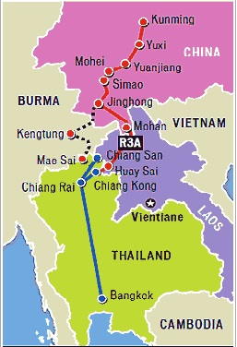
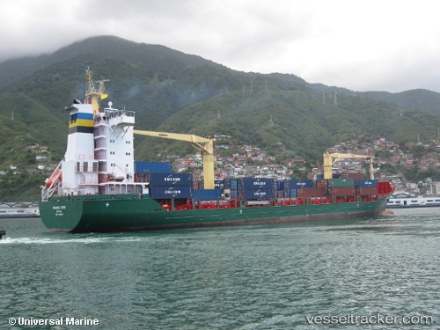
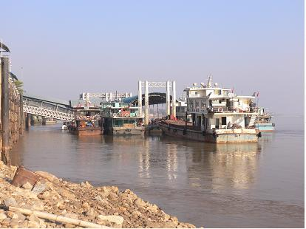
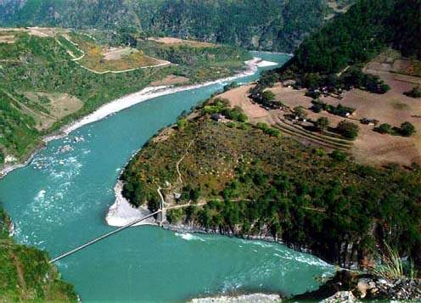
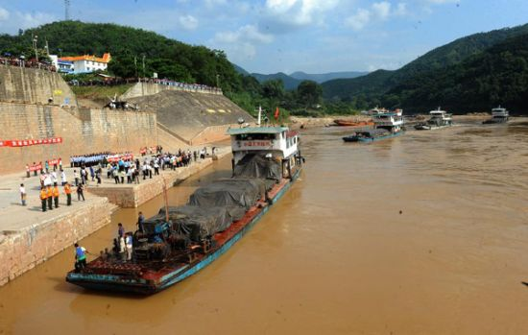
Comments and Discussion

